Slide 1
ERD Register Material
Rizki Darmawan

Slide 2
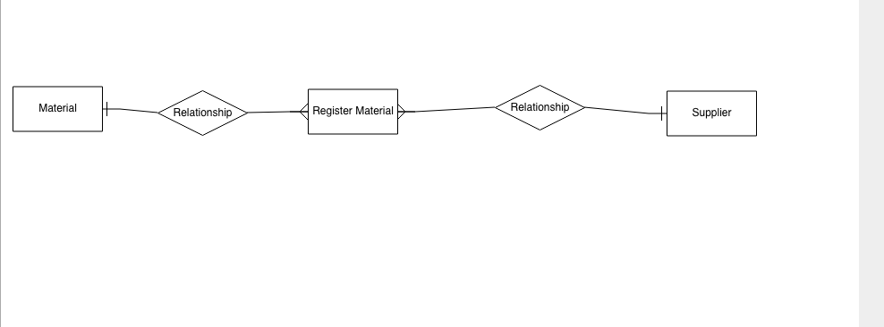
ERD

